Slide 1
Instructions for Use
Target audience: High school juniors and seniors
Populate Slide 3 with photo(s) and information about your company (what you make, who you make it for, what kinds of occupations you have, etc.)
Bring a product you make to show the students; describe the start-to-finish process
Leave time at the end for Q&A
Reach out to your local MEP or ISP for help with hands-on activities or additional localized industry information

Slide 2
Career Exploration: Modern Manufacturing
There is a home for you in Ohio’s largest industry.

Slide 3
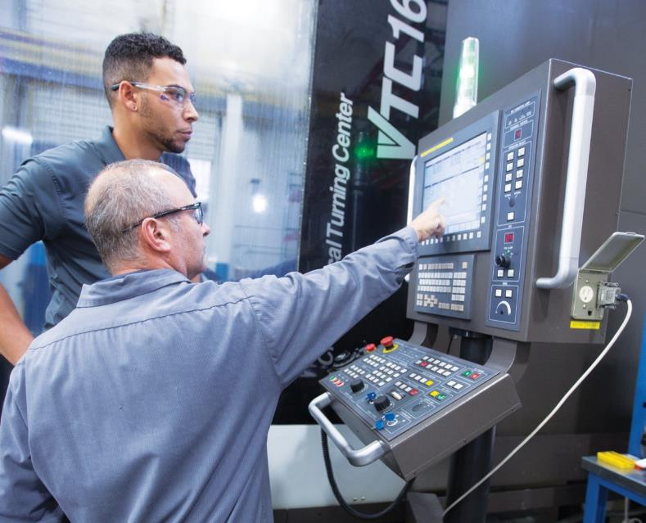
Exploring Rewarding Careers in Manufacturing
Manufacturing is a diverse industry offering numerous opportunities and many ways of entering

Slide 4
Here’s Where I Work
Add key points about your workplace here
Where you are
What you make
Who/what industries you make it for
How many employees?
Provide a sampling of career paths/opportunities
Include a photo or two

Slide 5
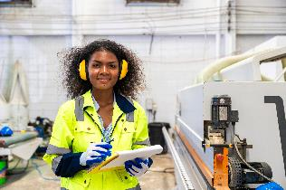
Why Manufacturing?
MANUFACTURING POWERS OHIO’S ECONOMY
690,000 jobs statewide – third behind only Texas and California
17.5% of the state's GDP (2023) – highest of all sectors
More than 13,000 manufacturing companies in the state

Slide 6
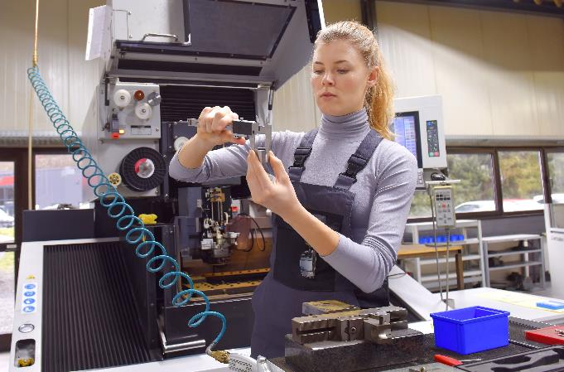
Debunking Myths
TODAY’S MANUFACTURING IS CLEAN, TECHNOLOGY-DRIVEN AND SAFE
MODERN MANUFACTURING FACILITY

Slide 7
Ohio Manufacturing Pays
Workers earn an average salary of $70,000, or $31.38 per hour (2023)

Slide 8
Common Manufacturing Careers
OPPORTUNITIES EXIST FOR BOTH HANDS-ON WORK AND MANAGERIAL ROLES
Industrial Engineers
Machinists
Production Associates/Technicians
Production Supervisors
Robotics/Automation Technicians
Welders

Slide 9
Training Pathways
COLLEGE DEGREE/DEBT NOT REQUIRED
Vocational training
Technical schools
Apprenticeships
On-the-job training

Slide 10
Benefits of a Manufacturing Career
Excellent Pay
Health/Retirement Benefits
Job Security
Growth Opportunities

Slide 11
Future of Manufacturing
MANUFACTURING IS HERE TO STAY AND EVOLVING WITH AUTOMATION, ROBOTICS AND SMART TECHNOLOGIES

Slide 12
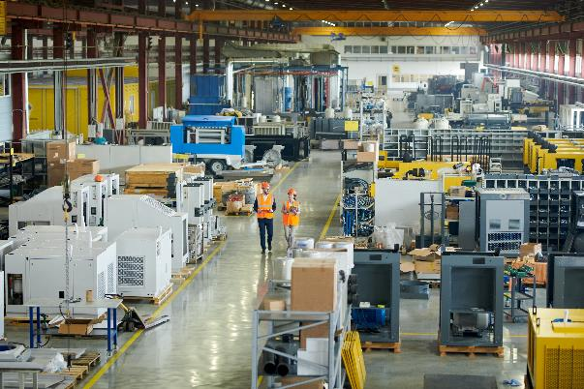
How to Get Started
Add your local context here
Your local ISP contact info
What kind of training is required for being hired?
Who are the training providers in your area?
How would a student apply for a position after graduation?
Logos here (yours and your ISP)

Slide 13
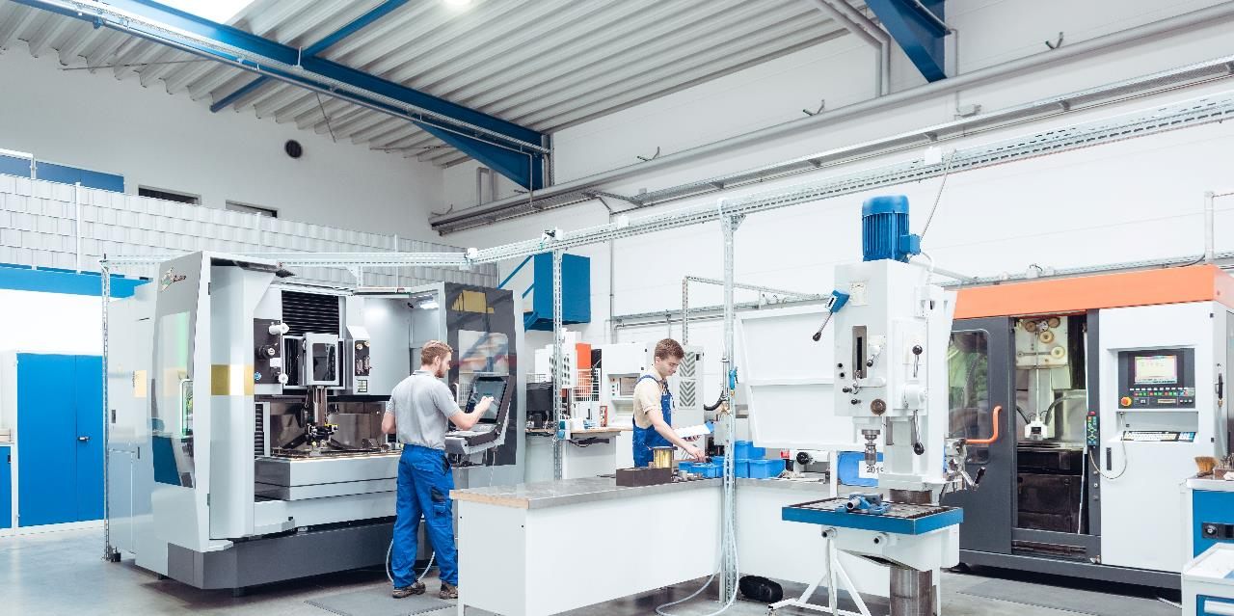
For more information about careers in Ohio’s
modern manufacturing industry, visit MakingOhio.com.

